Slide 1
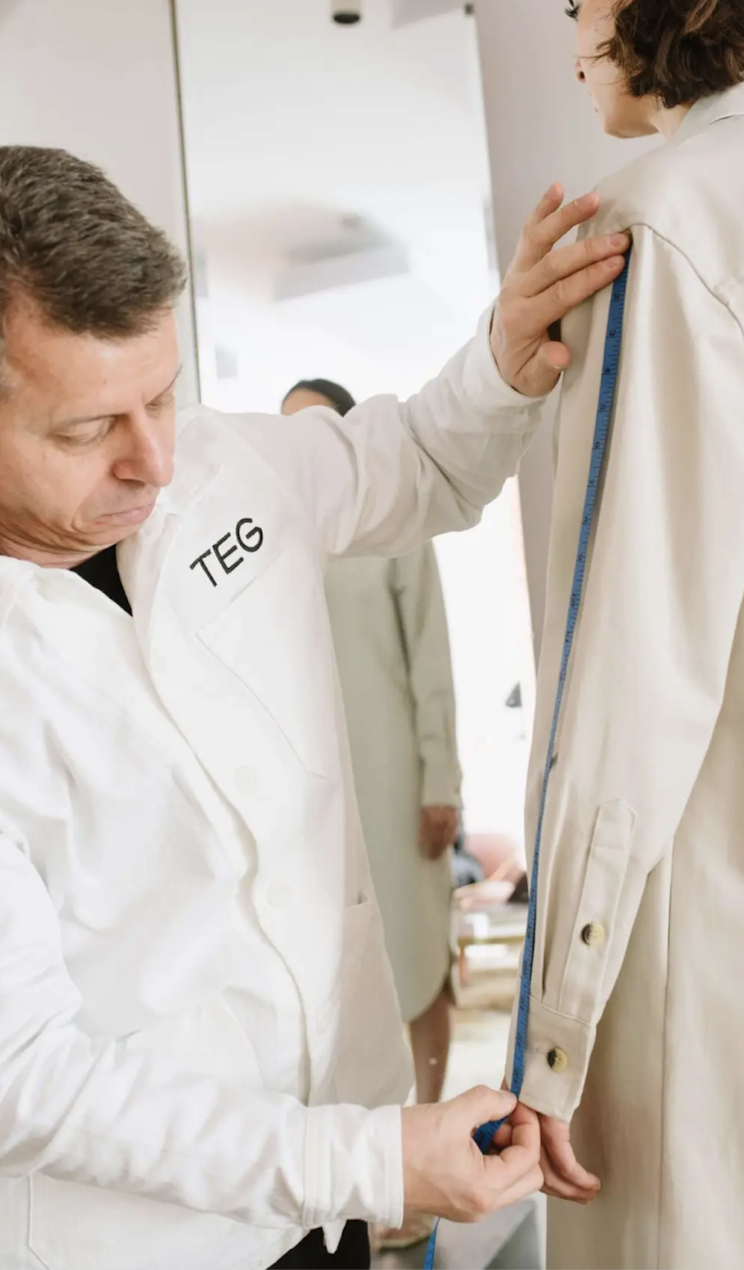

Slide 2
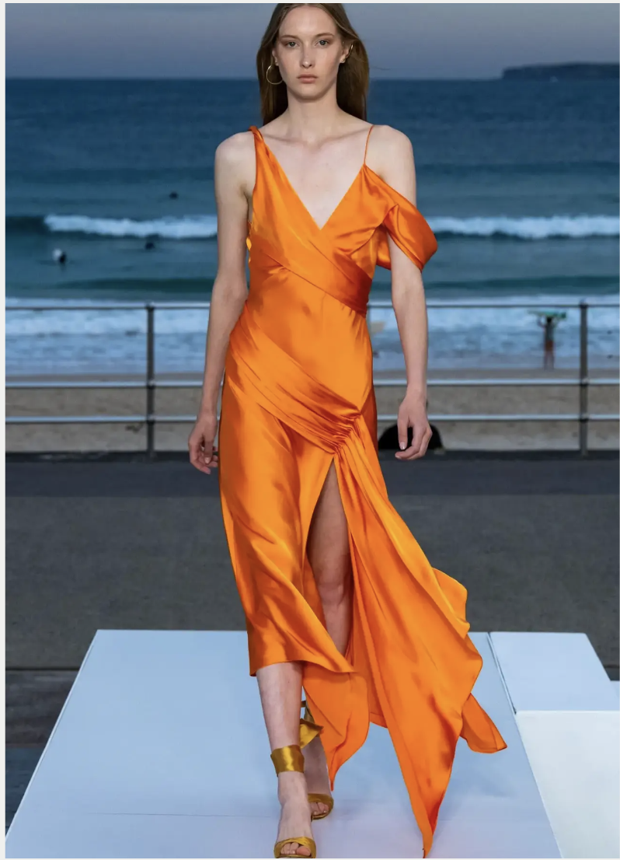
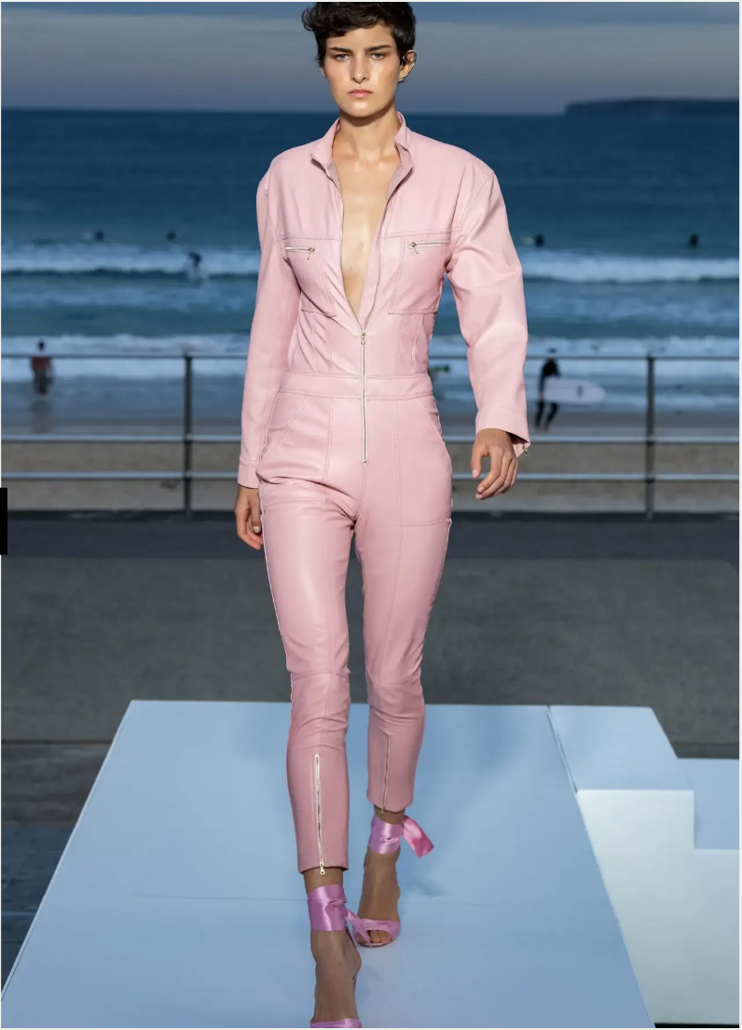
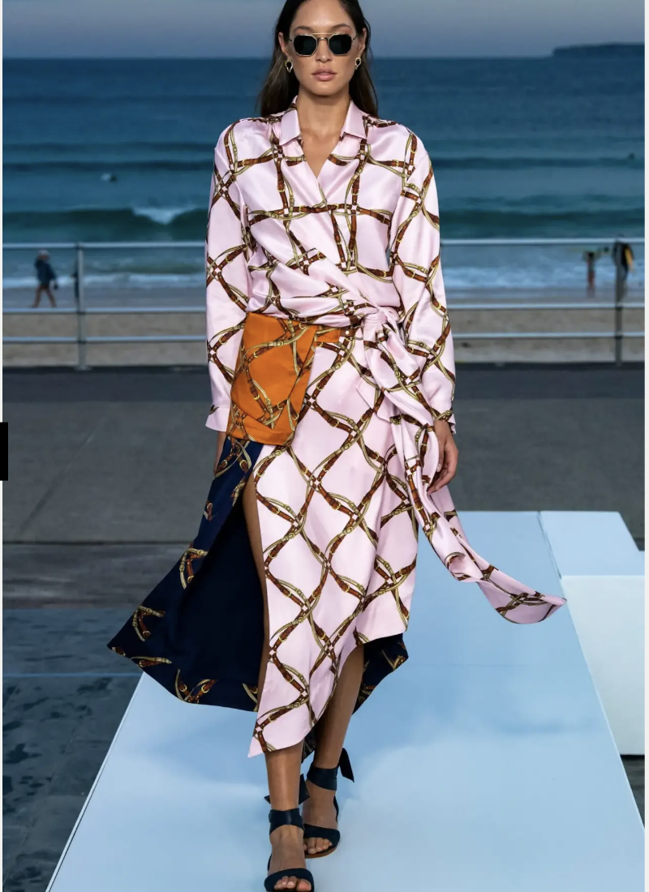
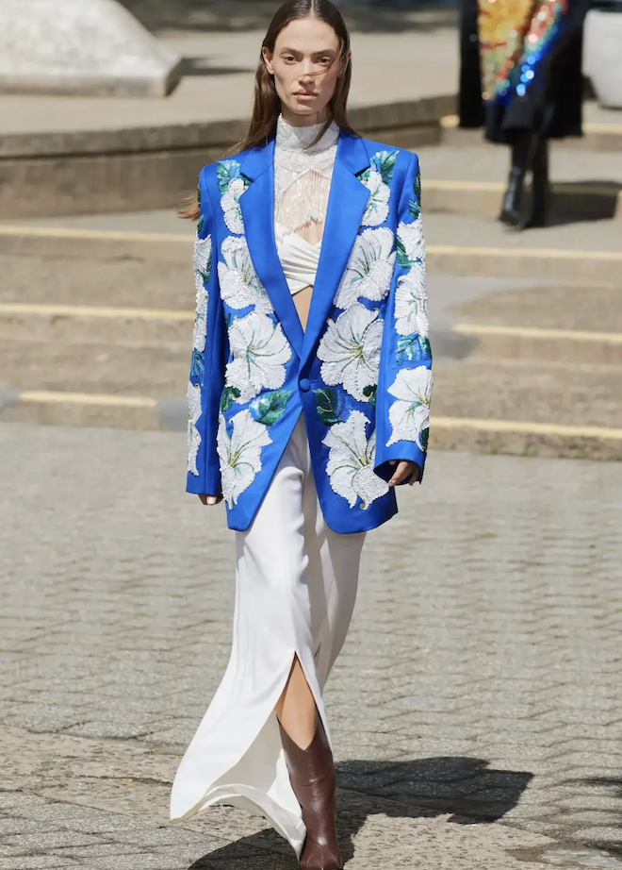
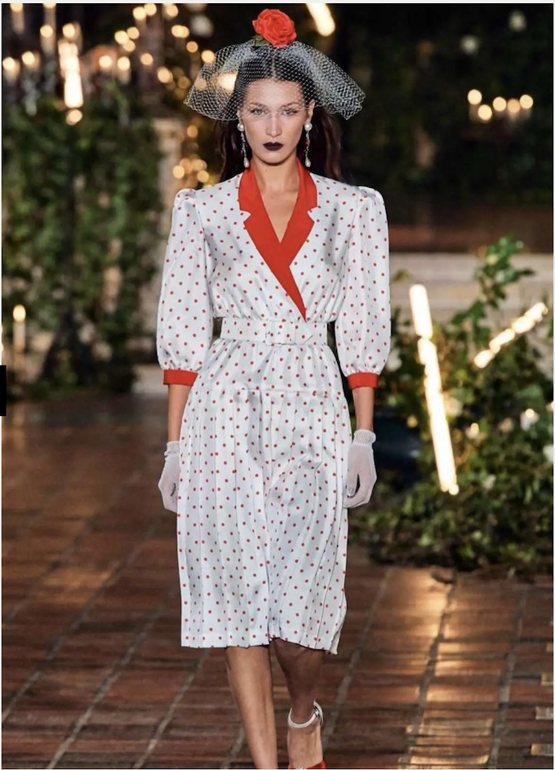
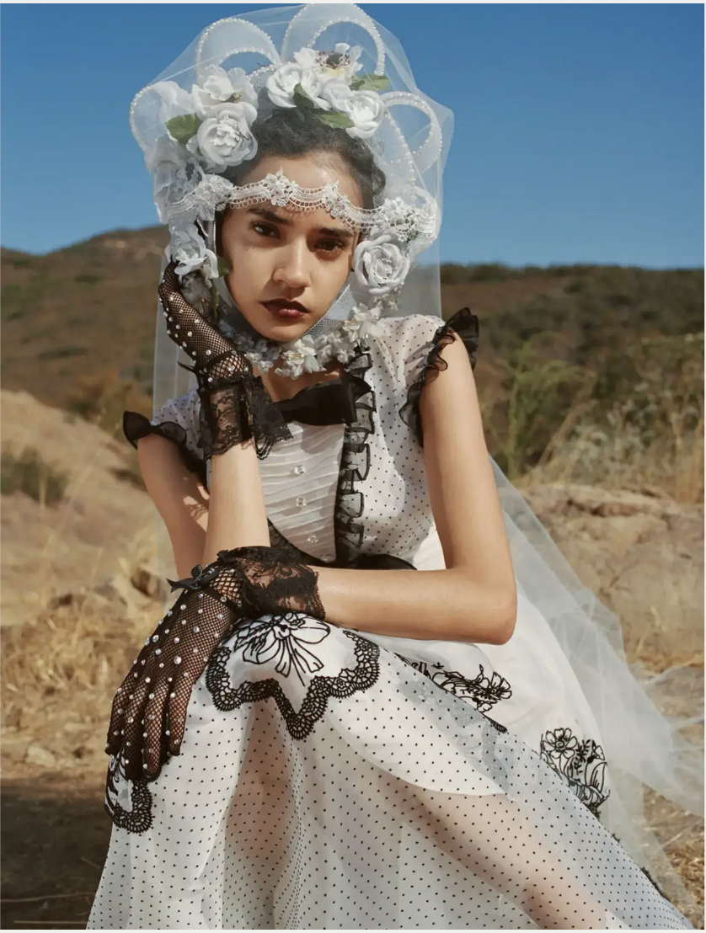
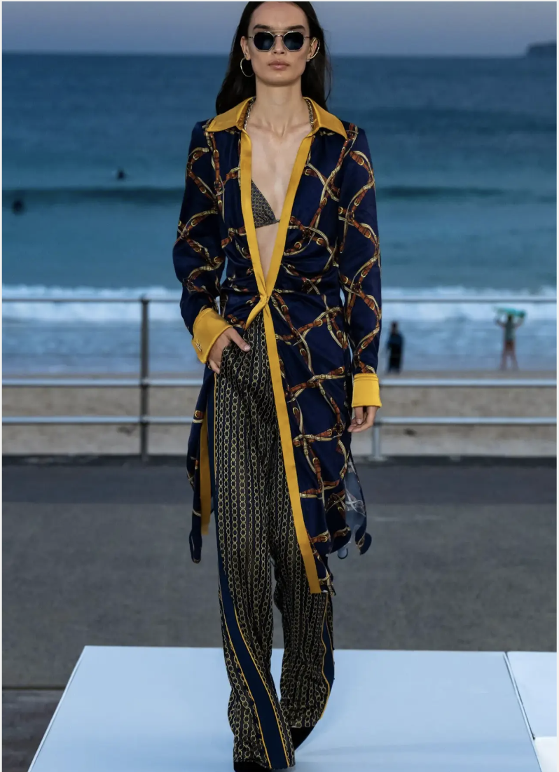
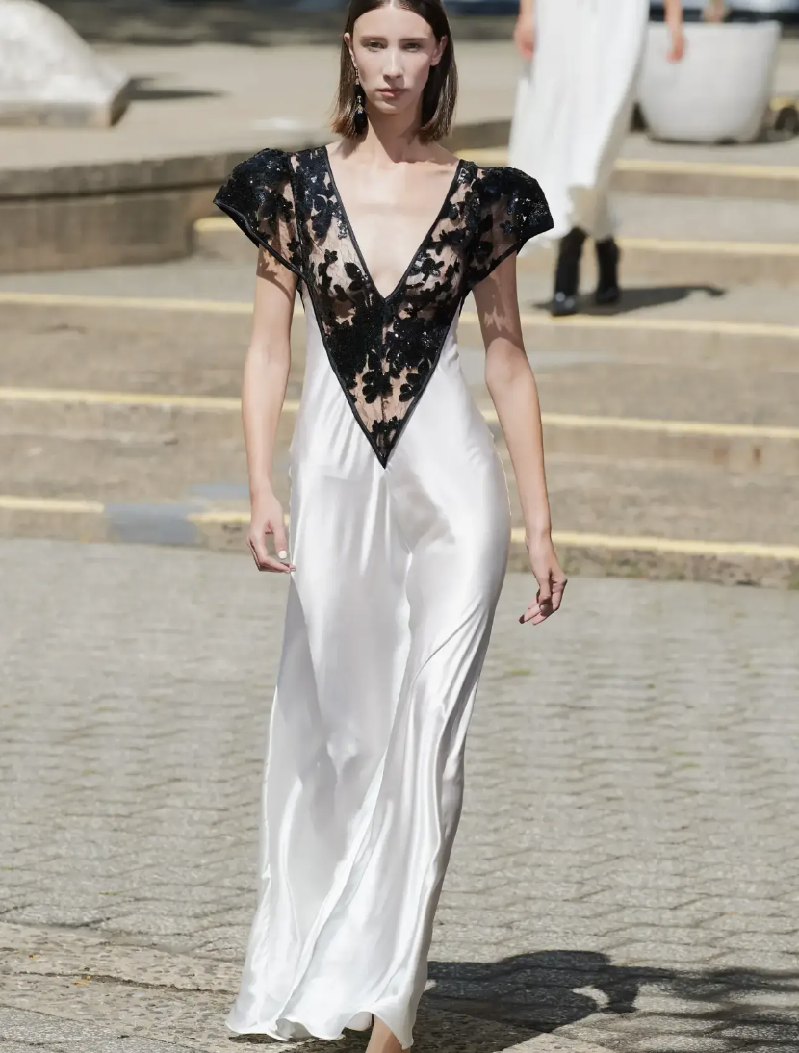
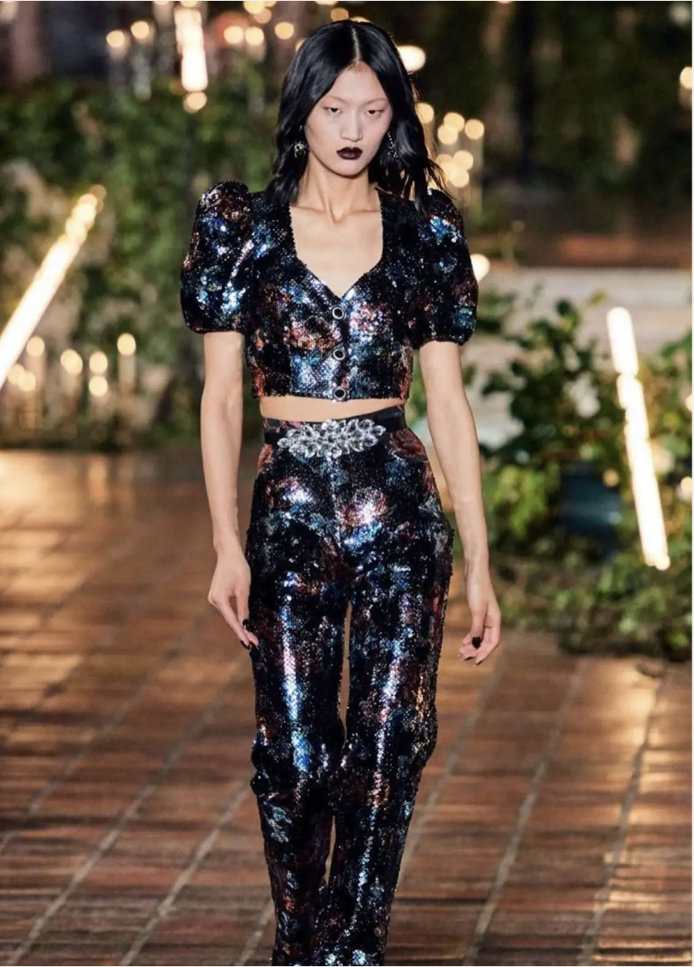
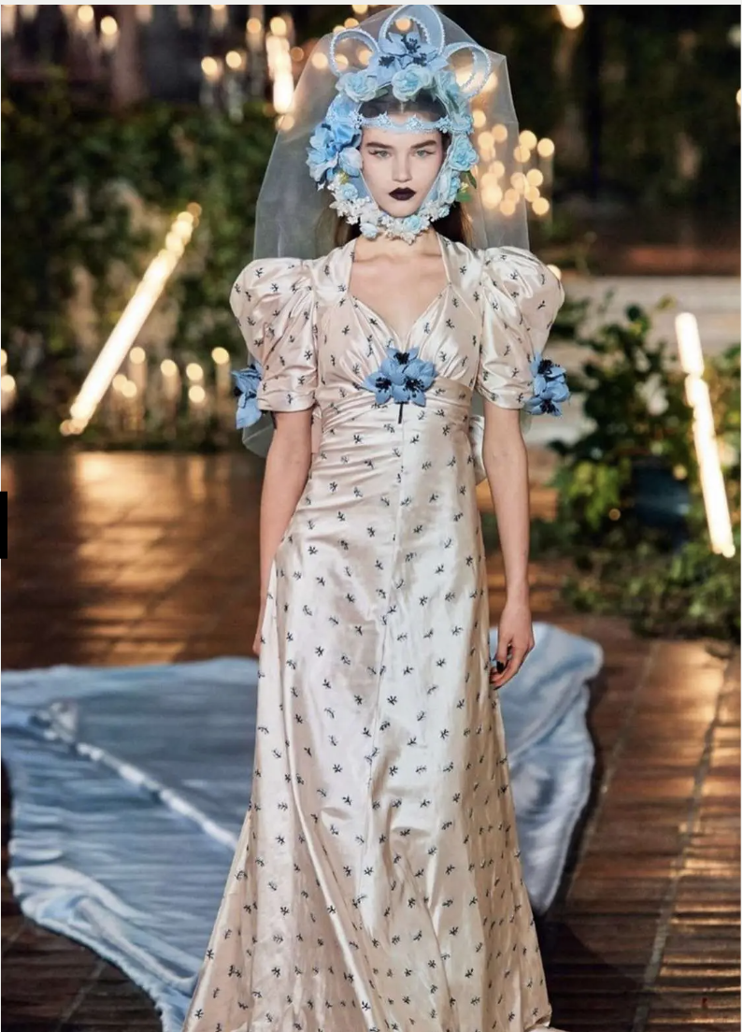
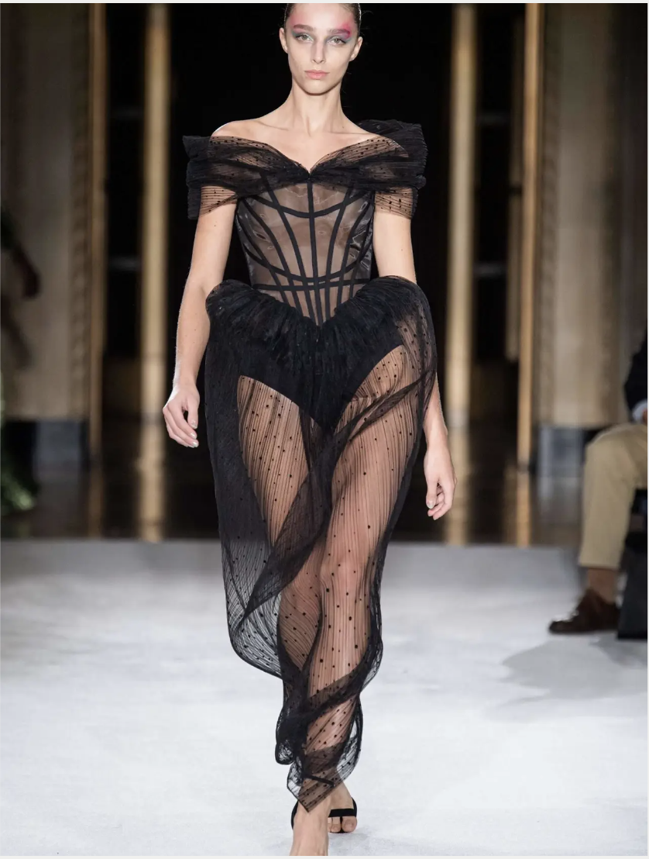
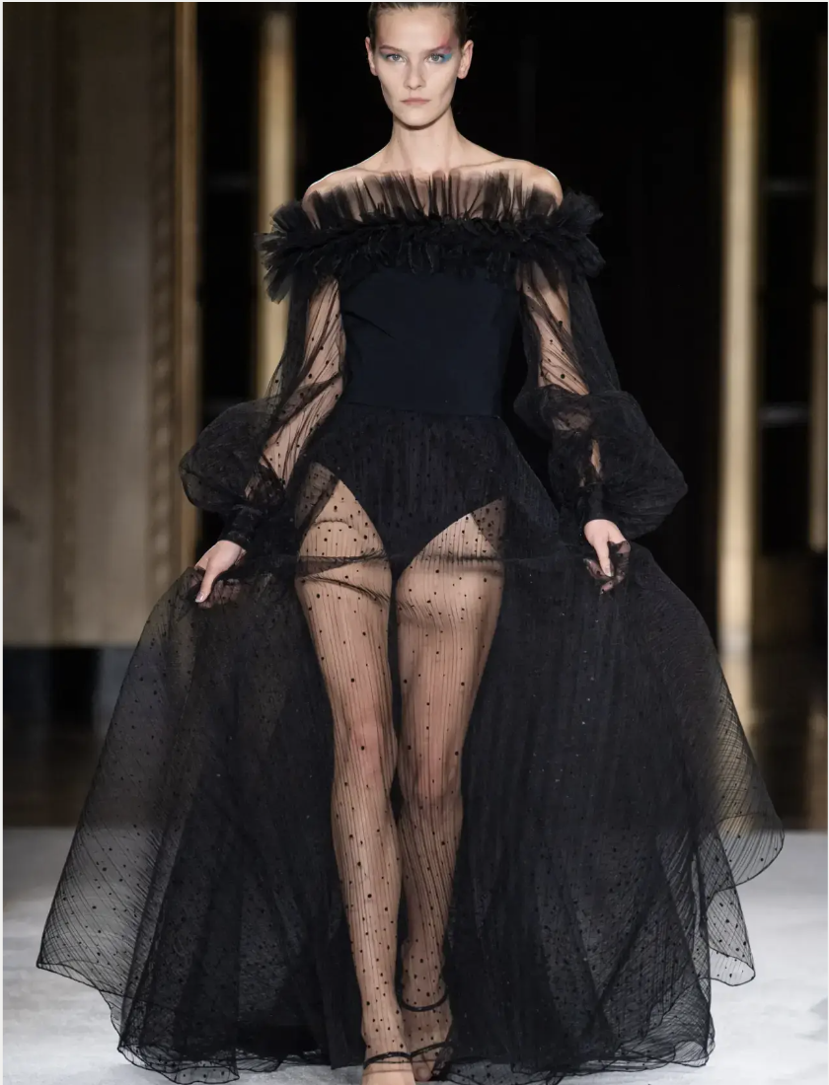
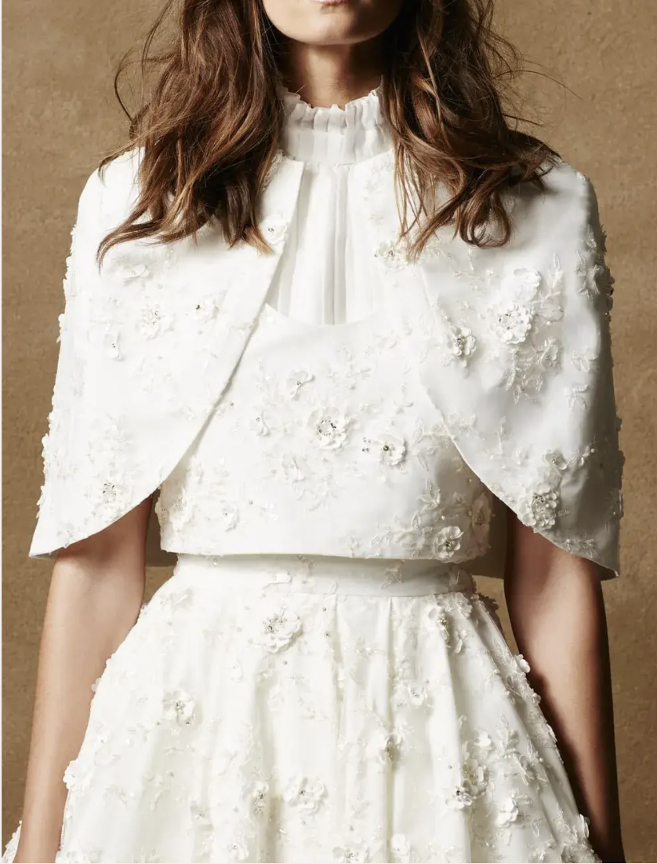
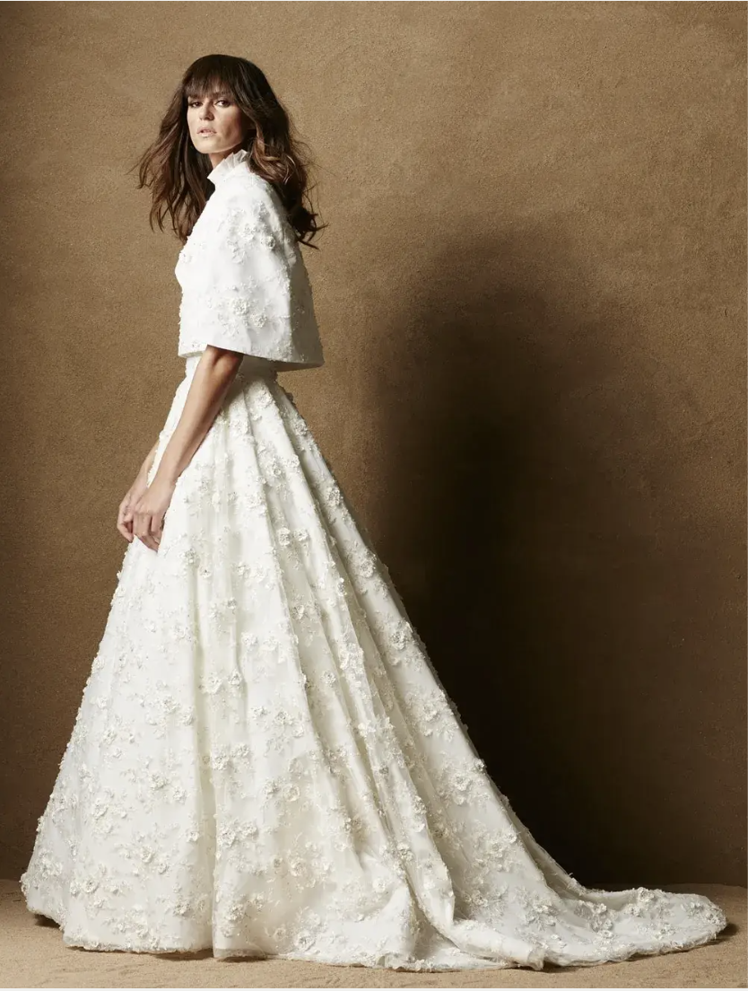
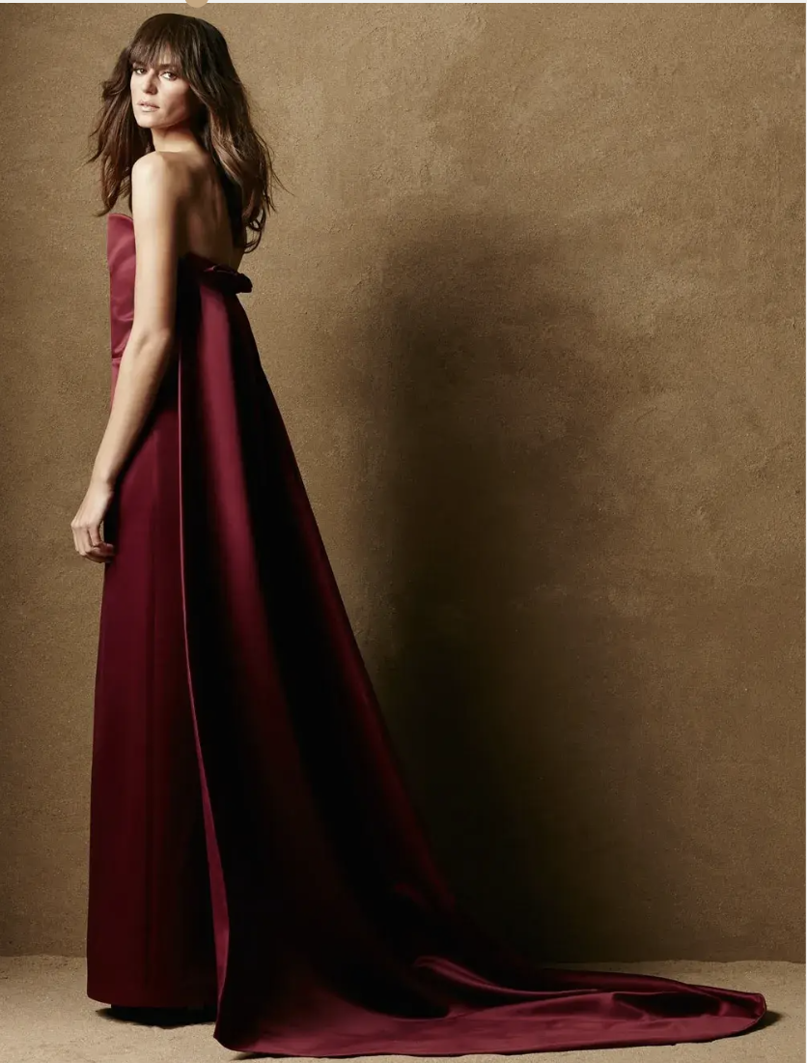
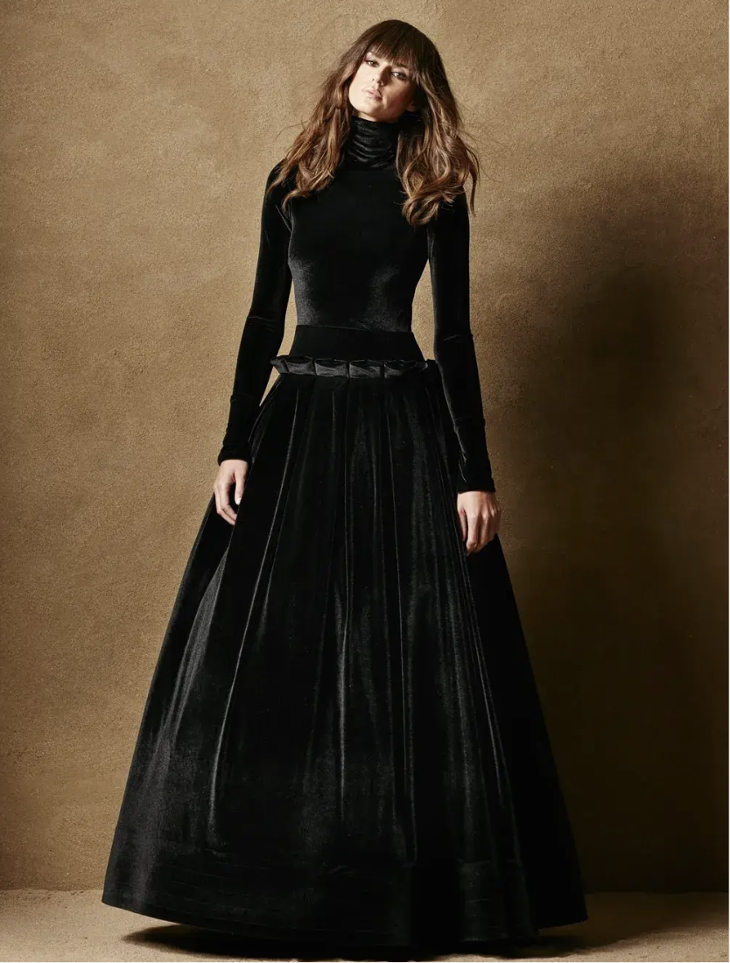
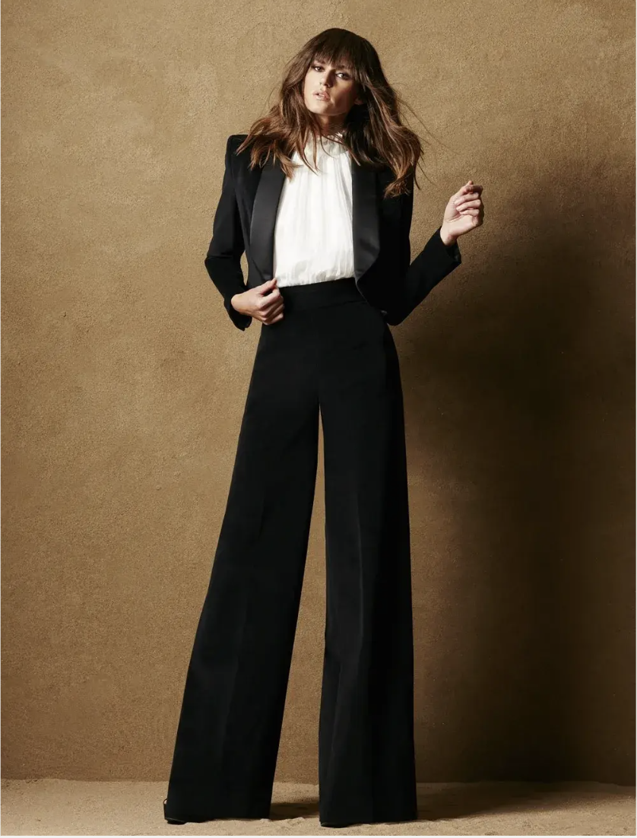
JONATHAN SIMKHAI -WOMEN’S CONTEMPORARY, COUTURE
RODARTE - WOMEN’S CONTEMPORARY, COUTURE OR OTHER RODARTE IMAGES LINKED HERE
CAROLINE HAYDEN - BRIDAL / COUTURE
CHRISTIAN SIRIANO - BRIDAL / COUTURE

Slide 3
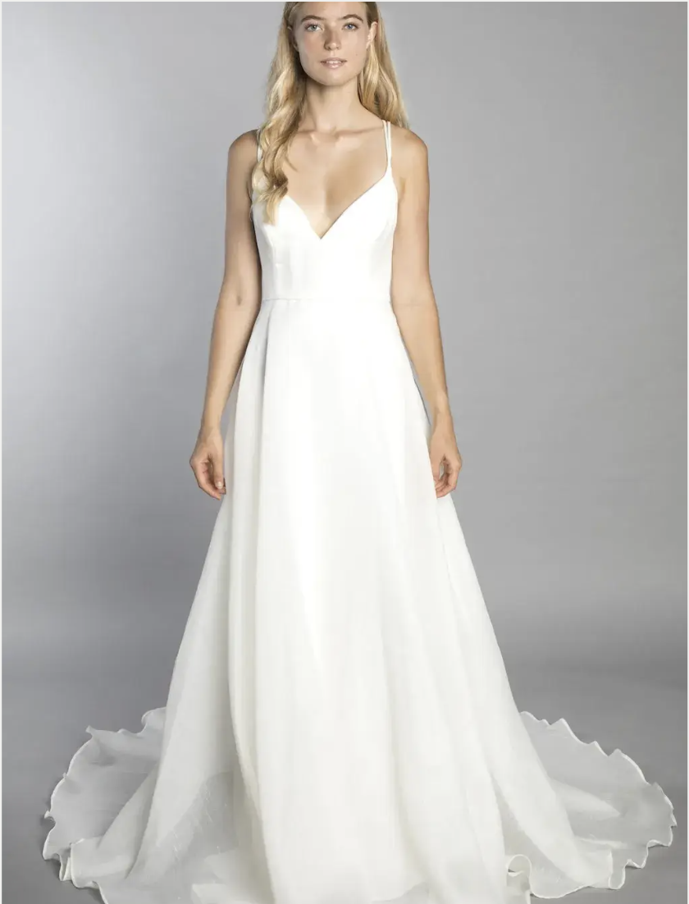
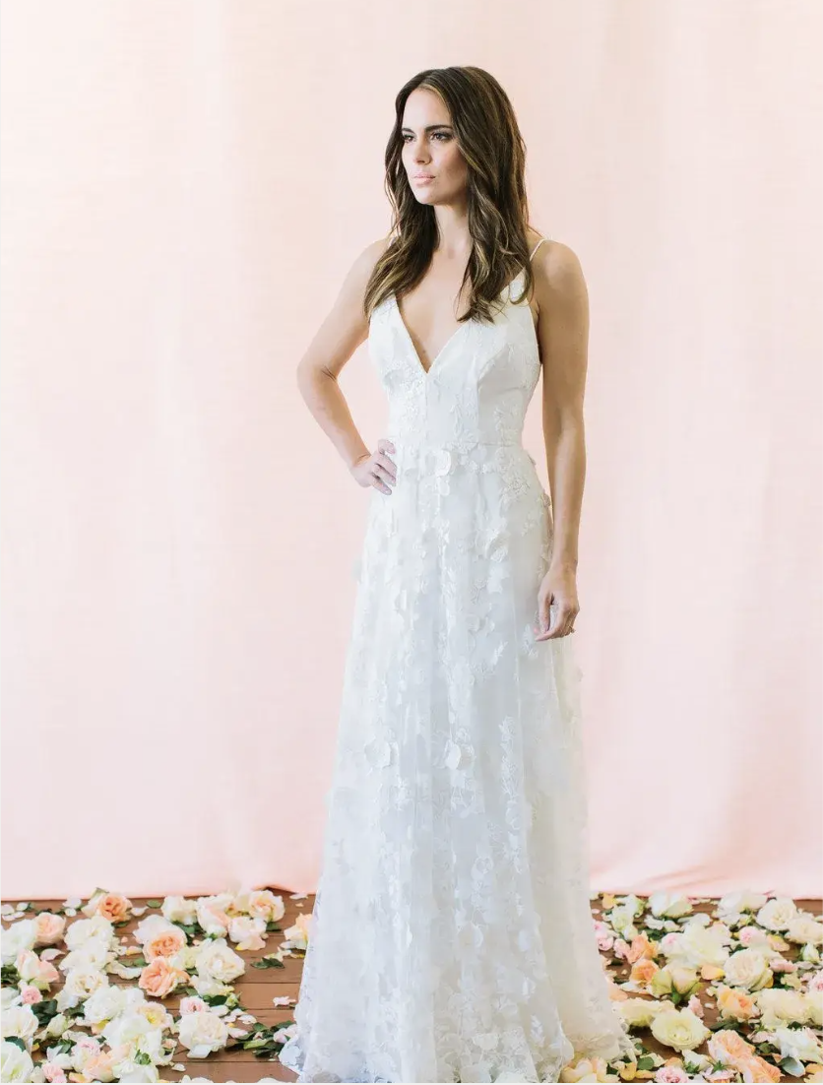
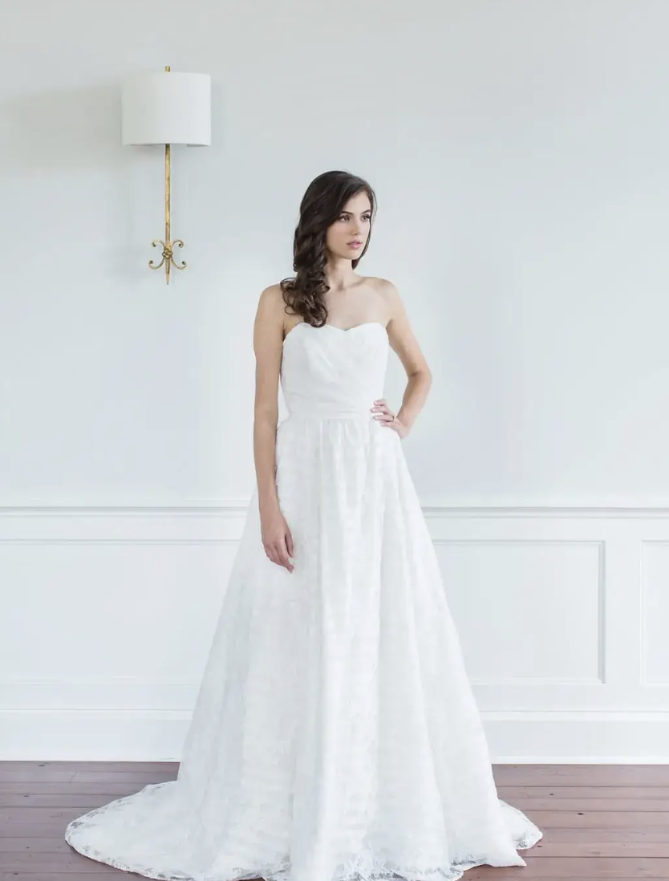
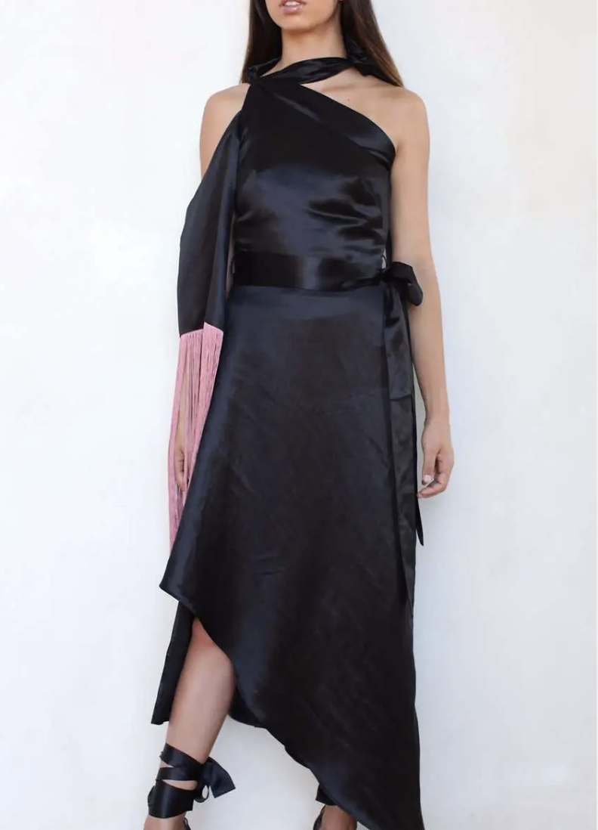
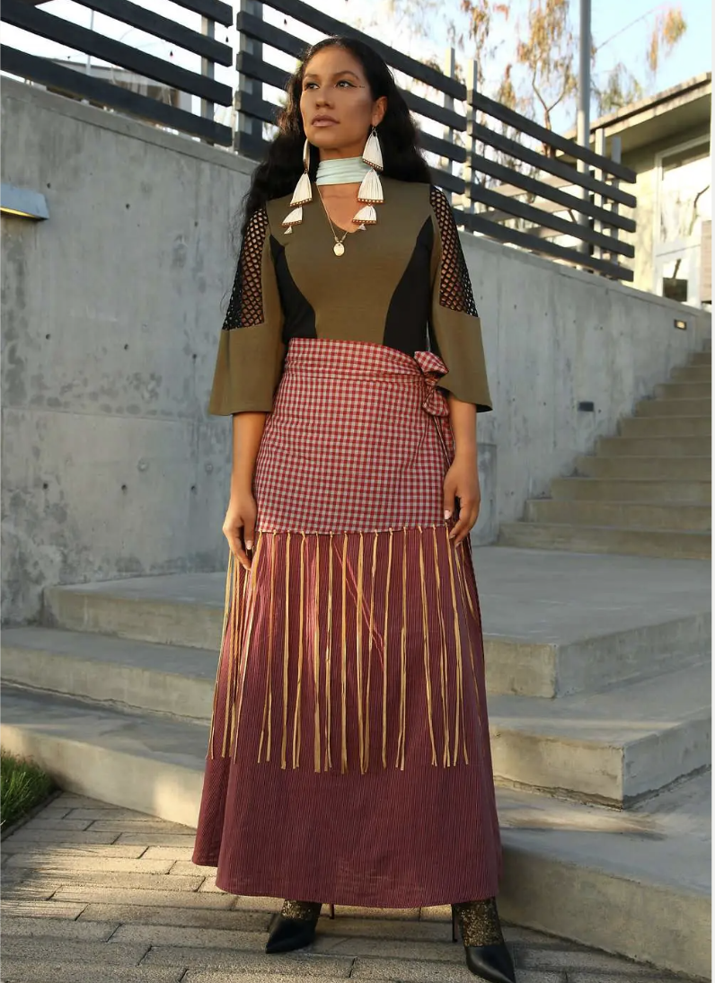
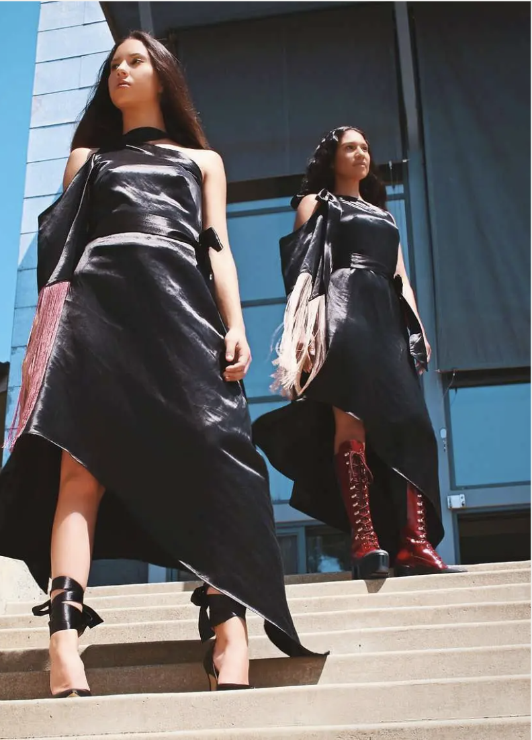
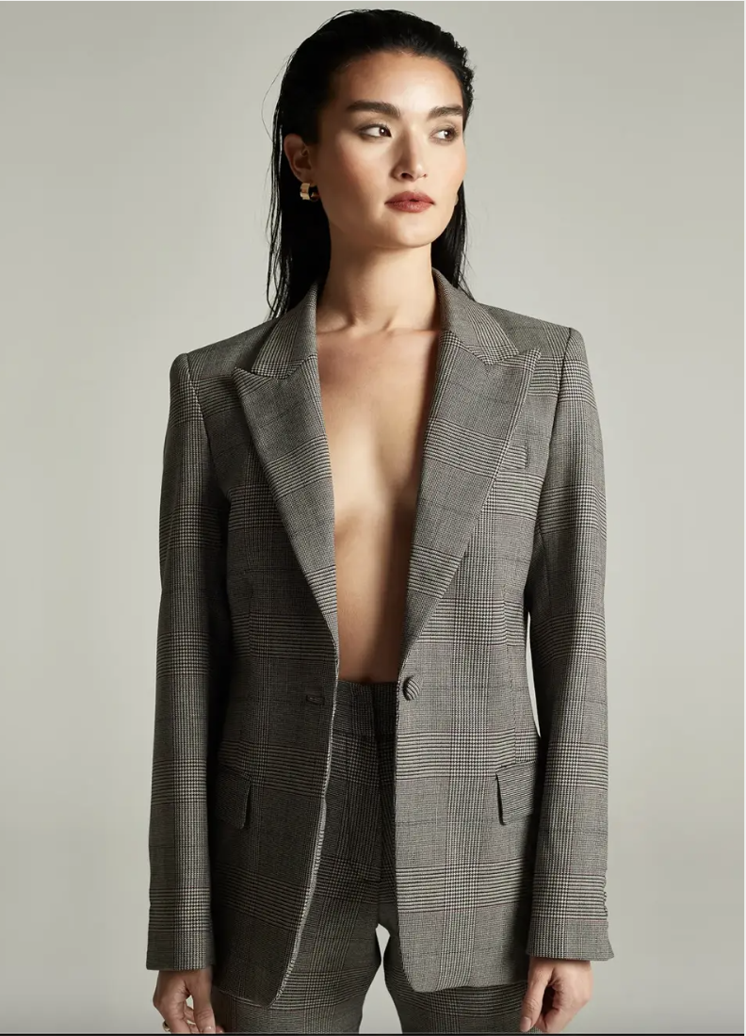
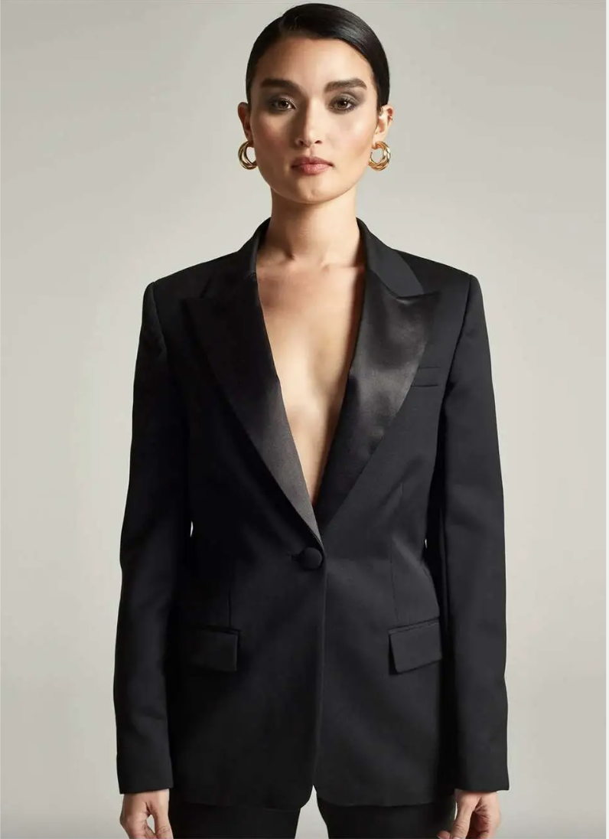
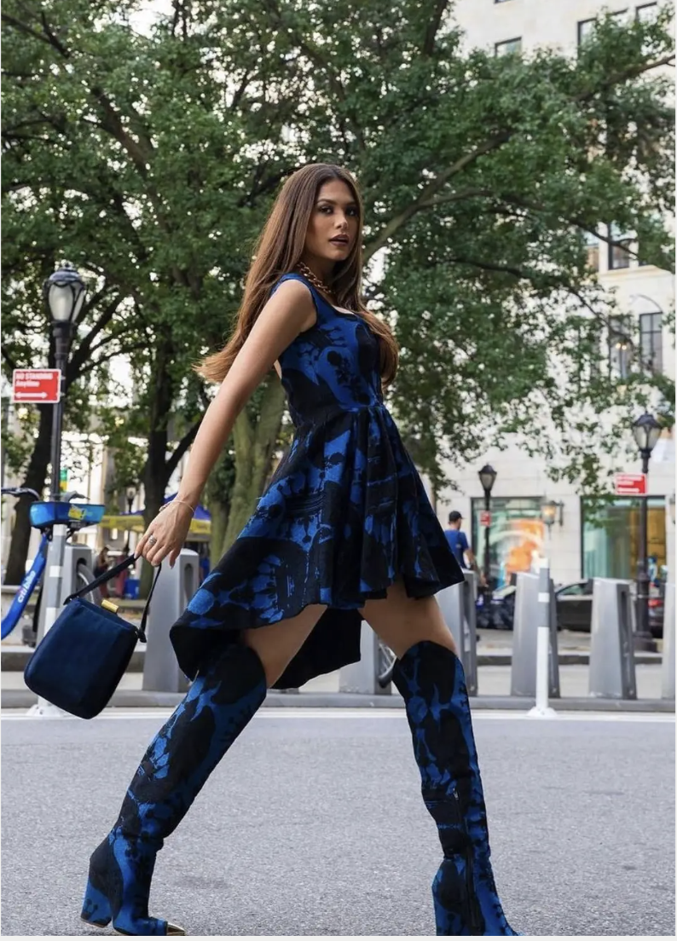
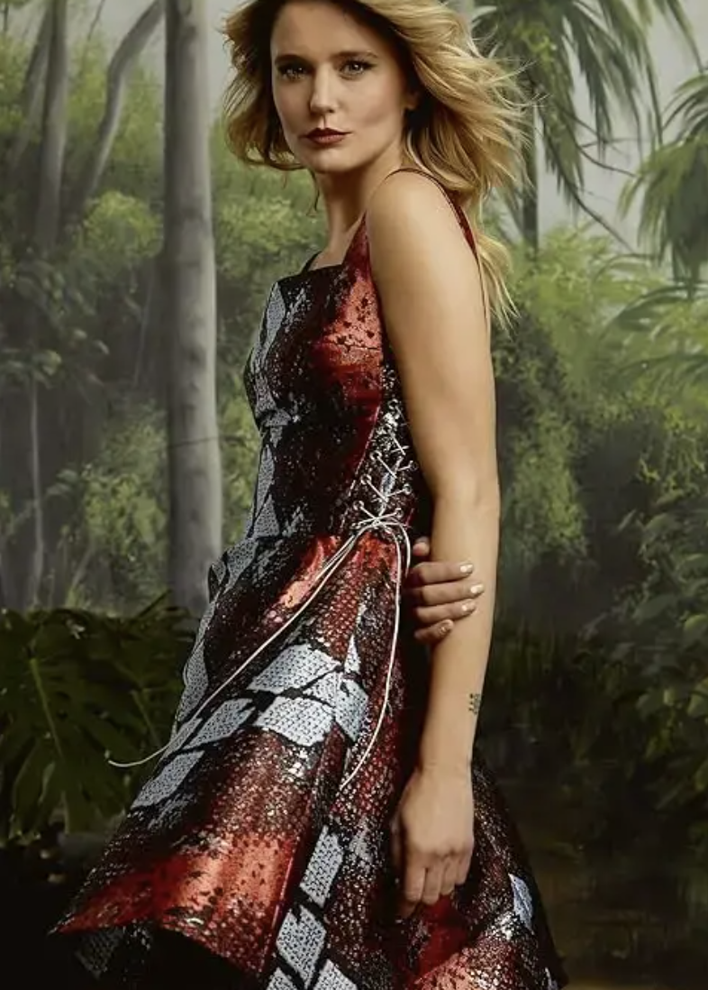
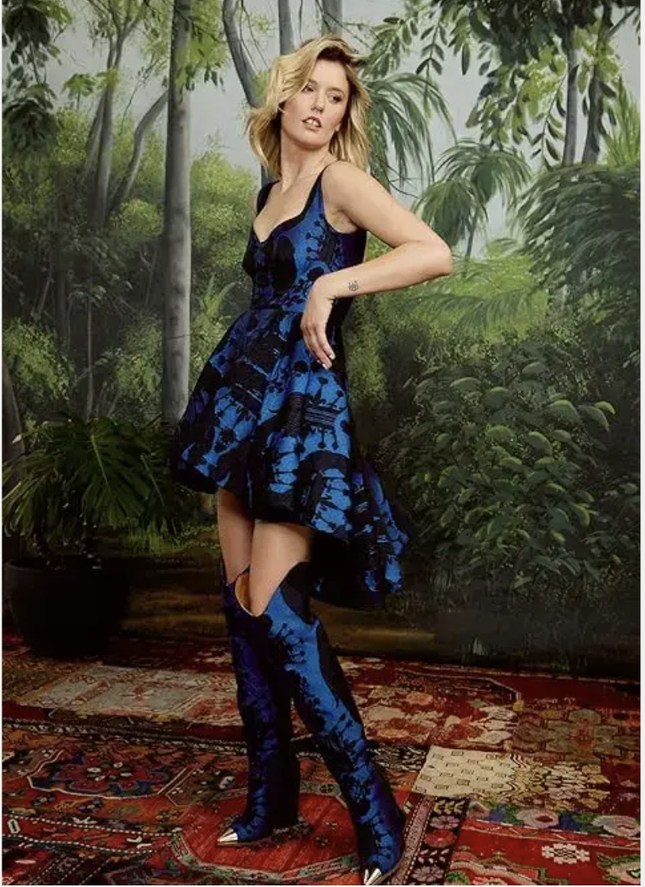
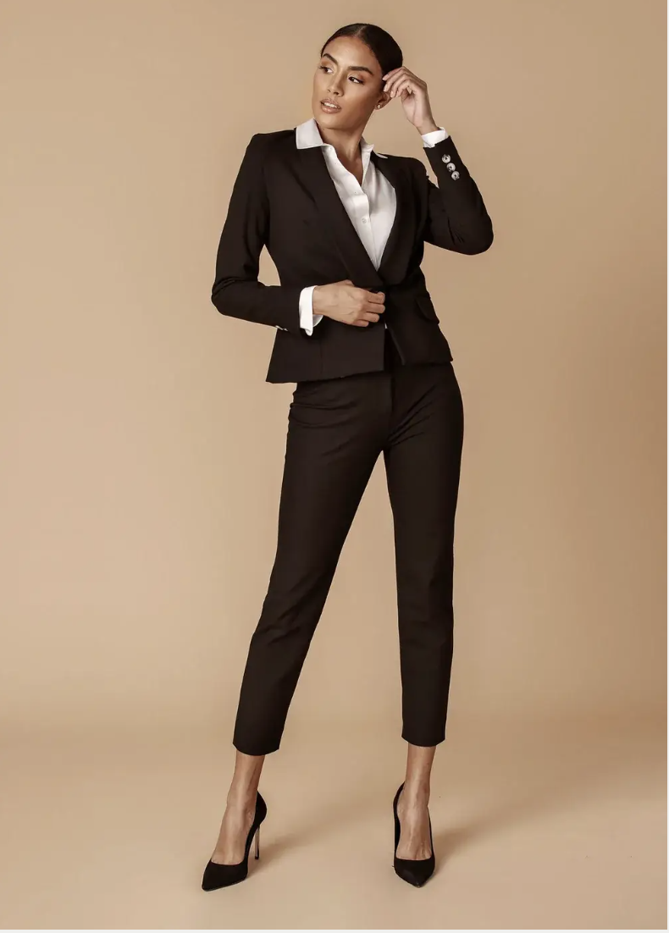
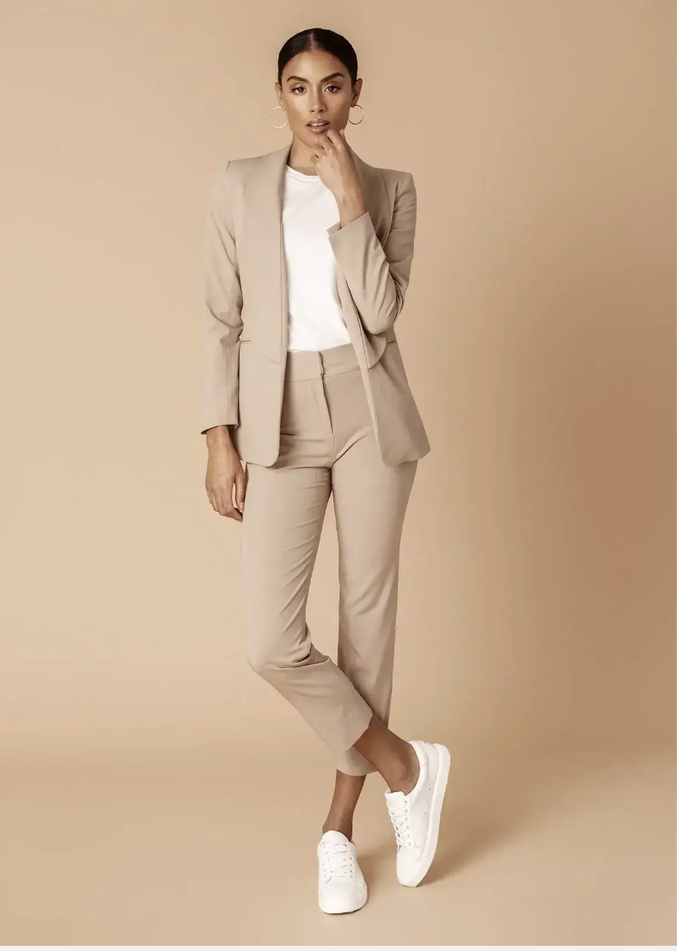
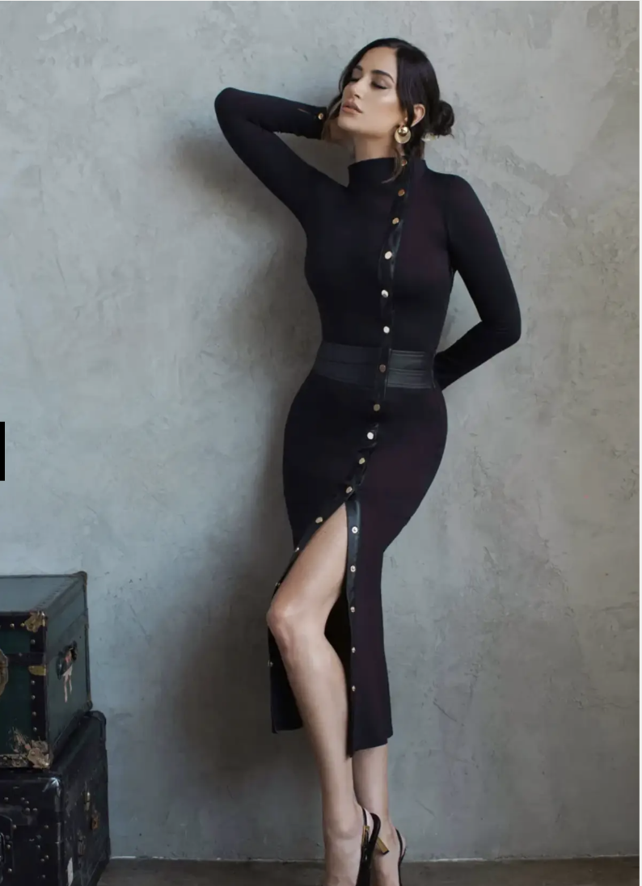
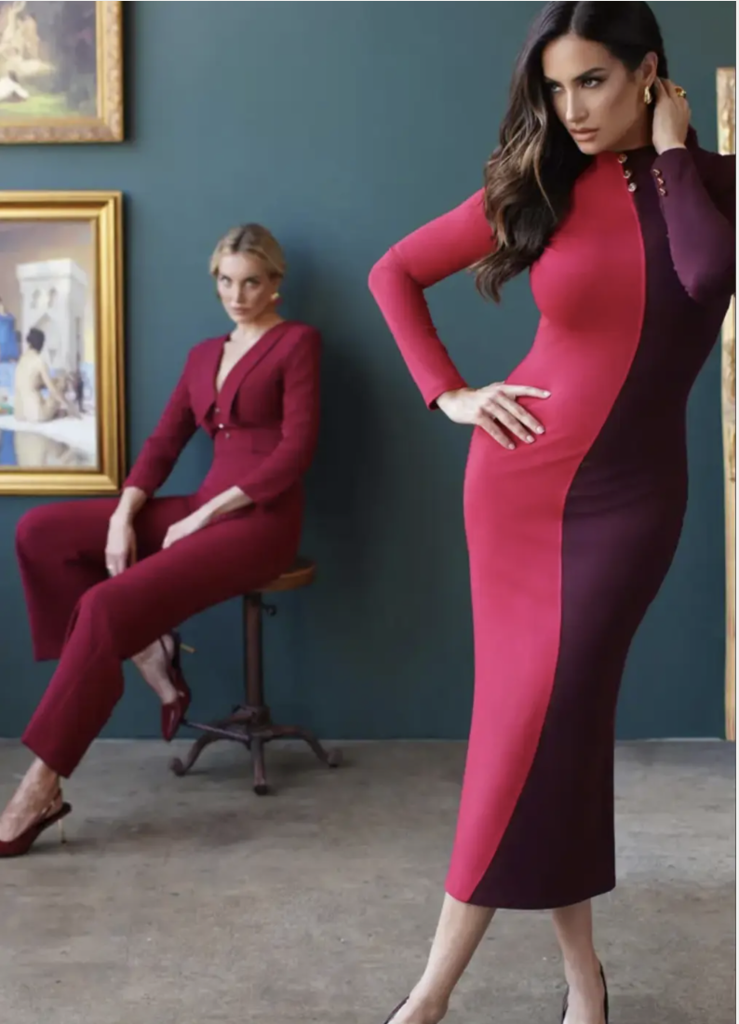
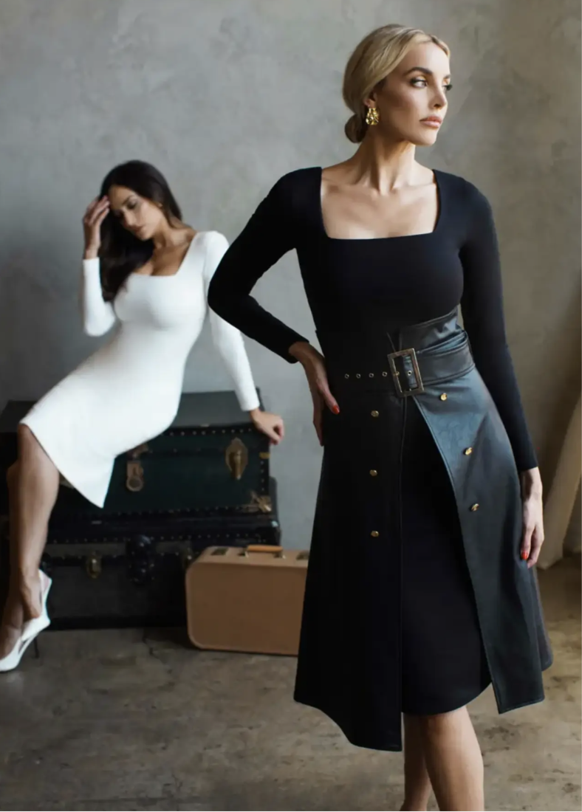
KATE MCDONALD -WOMEN’S BRIDAL / COUTURE
JAMIE OKUMA - WOMEN’S CONTEMPORARY OR STANDARD
DULCE BESTIA - WOMEN’S CONTEMPORARY OR STANDARD
TSAM - WOMEN’S CONTEMPORARY OR STANDARD
ZETAYE - WOMEN’S CONTEMPORARY OR STANDARD
MADISON SAVILE - WOMEN’S CONTEMPORARY OR STANDARD

Slide 4
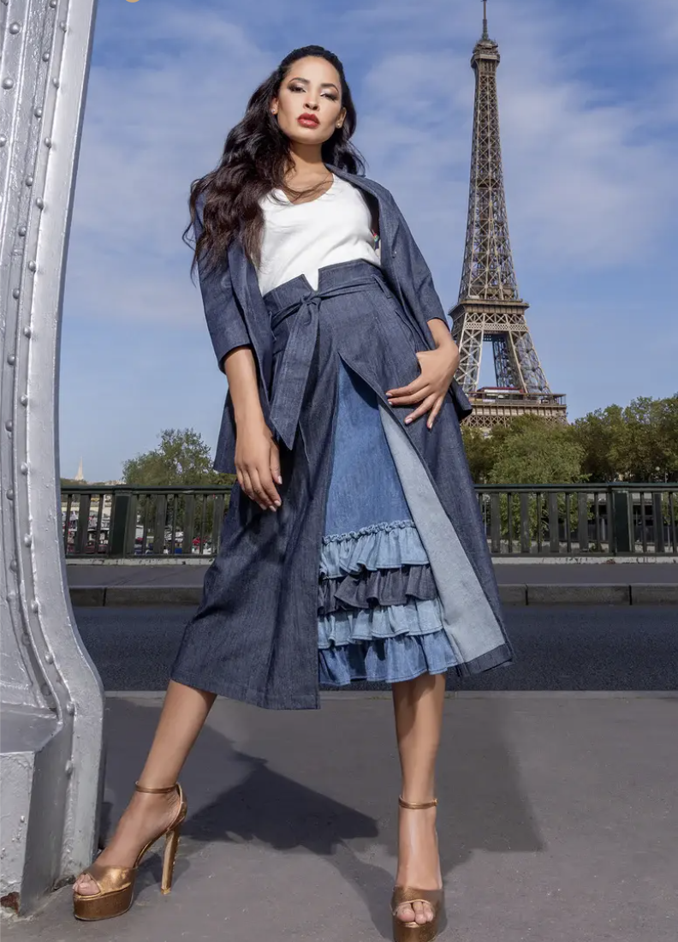
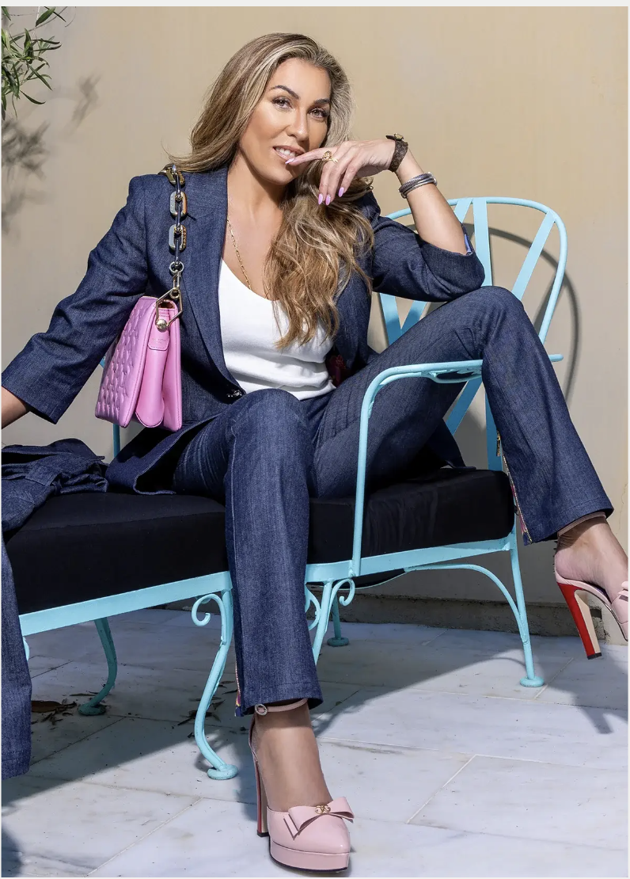
LE PEONY - WOMEN’S CONTEMPORARY OR STANDARD
JAMIE OKUMA - WOMEN’S CONTEMPORARY OR STANDARD
DULCE BESTIA - WOMEN’S CONTEMPORARY OR STANDARD
TSAM - WOMEN’S CONTEMPORARY OR STANDARD
ZETAYE - WOMEN’S CONTEMPORARY OR STANDARD
MADISON SAVILE - WOMEN’S CONTEMPORARY OR STANDARD

